Slide 1
SPINAL CANAL STENOSIS
University Of Karachi
Department Of Computer Science
Group Members: M Osama Jamil
M Hamza Temuri
M Moiz Khan
Course Supervisor: Dr. Humera Tariq
10/20/2020

Slide 2
CONTENT ORGANIZATION
Problem Statement
Why It is important to Solve the Chosen Problem/Real life use cases
Input Data Acquisition and Format details
Expected outcome / Success criteria / Output screen shots
Proper Module Wise Labelled Block Diagram /Work flow
Intermediate Results ( Images / comparison tables/graphs /statistics)
GUI / client side view
Preprocessing Details
Annotations
Key Algorithm ( Your contribution and Innovation)
Challenges/ Difficulties
Learning and Achievements
Improvements needed and/or Future Work

Slide 3
PROBLEM STATEMENT
The objective of the project is to diagnose and detect spinal disease called Spinal Stenosis.
Spinal stenosis is a narrowing of the spaces within your spine, which can put pressure on the nerves that travel through the spine.

Slide 4
IMPORTANCE
To Solve the given Problem is important because if you have lumbar spinal stenosis, you may have trouble walking distances and You may also have pain or numbness in your legs.
We came up with an application/model which take your MRI as an input and process it and predicts if you have spinal problem or not and point out the areas where you have problem.

Slide 5
DATA ACQUISITION

Slide 6
Data Acquisition
The dataset we used for our project is taken from (https://data.mendeley.com/datasets/k57fr854j2/2).
The dataset contained about 515 patients MRI’s and each patient’s folder contained of MRI’s from either Sagittal or axial view.
Each view has about 15 to 25 MRI files.
The MRI files were in Dicom format.

Slide 7
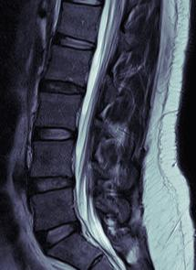
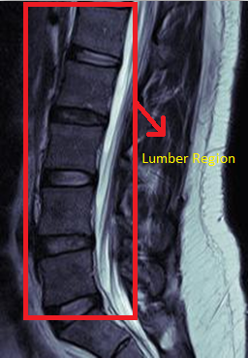
We have focused on Lumber region.
Some MRI’s from the dataset.
Sagittal view

Slide 8
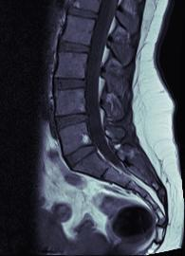
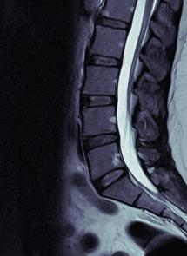
There are two main types of MRI sequences T1-weighted and T2-weighted MRIs.
T1-weighted scans are produced using short repetition and echo times.
T2-weighted scans are produced using longer TR & TE.
T1-weighted MRI
T2-weighted MRI

Slide 9
Workflow Diagram

Slide 10
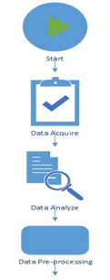
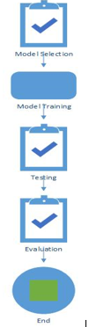
Workflow diagram:

Slide 11
WORKFLOW STEPS:
Data Acquisition
Data Analyze
Data Pre-processing
Model Selection
Model Train
Model Testing
Evaluation

Slide 12
GRAPHICAL USER INTERFACE

Slide 13
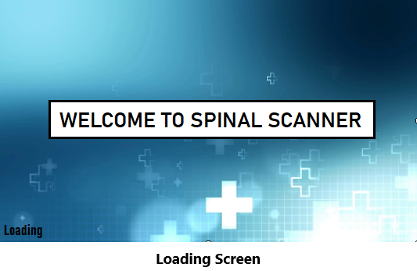
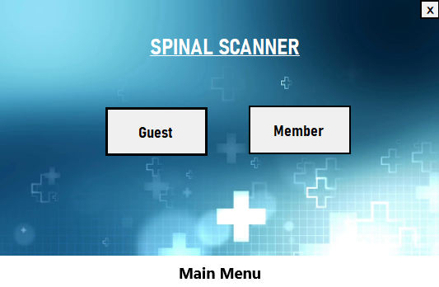
GUI
Guest user and Member
Guest user can perform detection of single image without logging in.
Member must have an account or register before using scanner and also perform detection on multiple images.

Slide 14
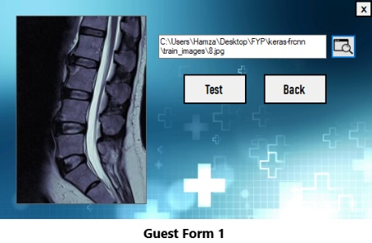
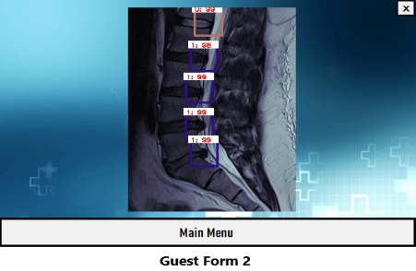
Browse image and begin testing.
Result image showing:
1 : xx = Defect : Probability
0 : xx = Fine : Probability

Slide 15
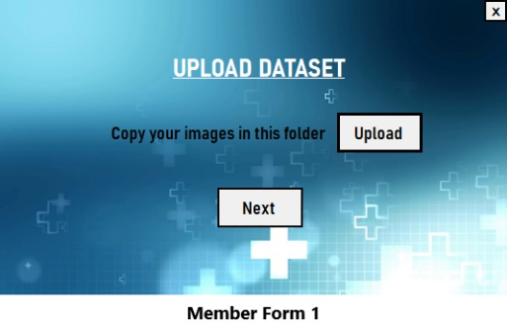
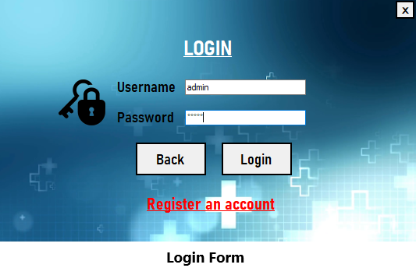
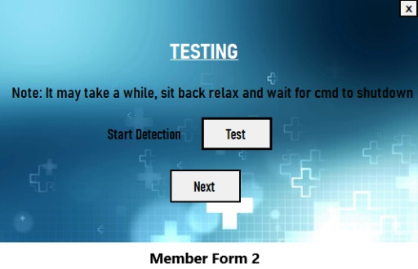
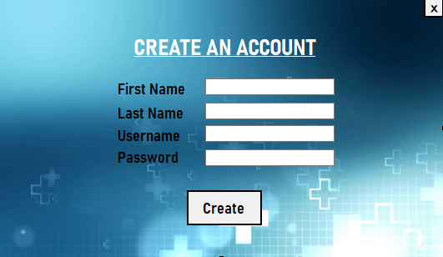
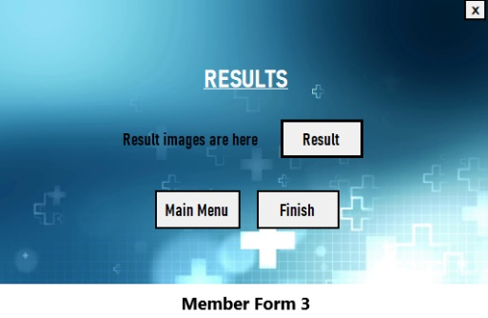
Upload images in folder.
Login with username and password / register.
Begin Testing.
Click Result button and folder containing result images pop-up.
Register Account.

Slide 16
Results

Slide 17
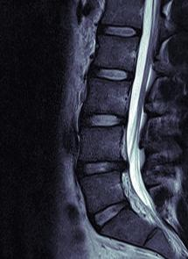
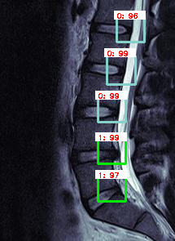
RESULTS
INPUT IMAGE
OUTPUT IMAGE

Slide 18
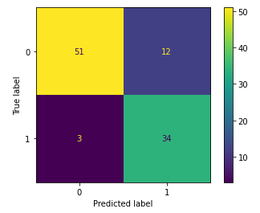

RESULTS
Confusion Matrix

Slide 19
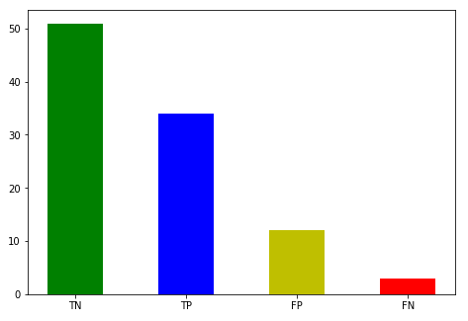
RESULTS
Confusion Matrix

Slide 20



RESULTS
Accuracy:
85%
Precision:
73%
Recall:
91%

Slide 21
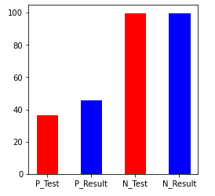
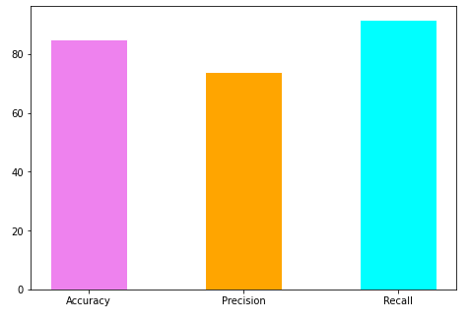
RESULTS

Slide 22
Pre-processing

Slide 23



PRE-PROCESSING
Image Format
Original format : .ima / .dicom ( Image Size = 200 – 300 kb )
Converted format : .jpg ( Image Size = 20 – 30 kb )
Normalization
$Xnorm=\frac{X − min\left(X\right)}{max\left(X\right) − min(X)}$

Slide 24

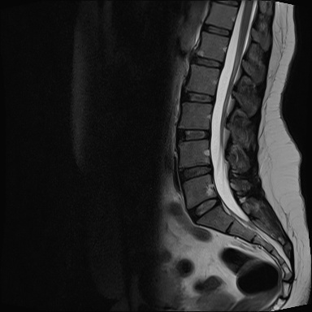
Cropping & Resizing
Original image resolution : ( 320 × 320 )
After cropping : ( 195 × 270 )
Final Image Size
12 - 15 kilobytes
195 × 270
320 × 320

Slide 25
Annotations

Slide 26
Annotations
Image annotation is the process of labeling or classifying an image using text, annotation tools, or both, to show the data features you want your model to recognize on its own.
Photo filter is used to annotate the images.
The size for the annotation box is (Width=35, Height=32).
xmin: x-coordinate of the bottom left part of the image.
xmax: x-coordinate of the top right part of the image.
ymin: y-coordinate of the bottom left part of the image.
ymax: y-coordinate of the top right part of the image.

Slide 27
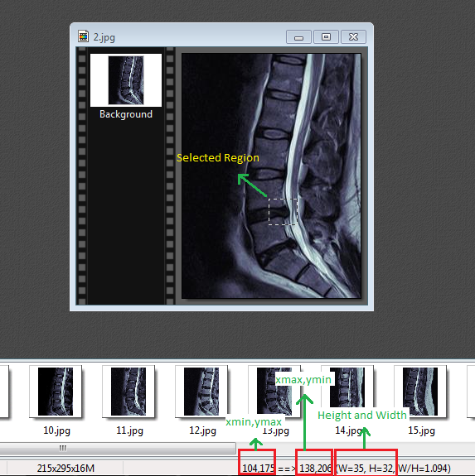
Here is a snap for better understanding.

Slide 28
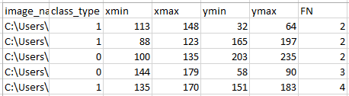
Snap of annotations entry in excel file.

Slide 29
ALGORITHM

Slide 30
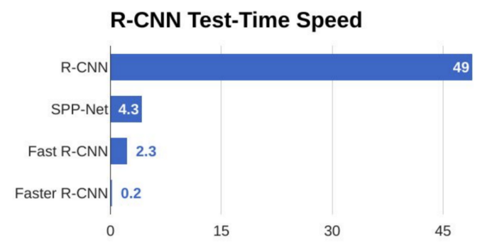
ALGORITHM: FASTER RCNN
Why we have chosen Faster RCNN?
Answer: Faster RCNN is much faster and accurate then its predecessors. Uses Region proposal network (RPN) technique.

Slide 31
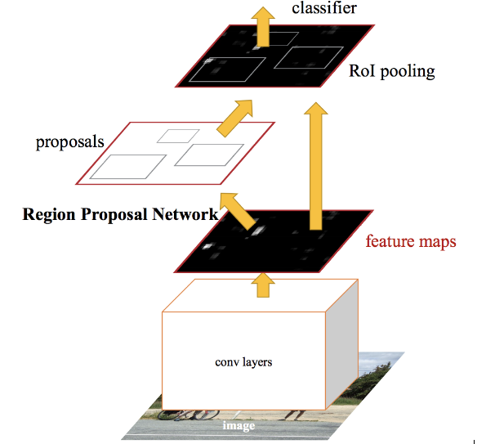
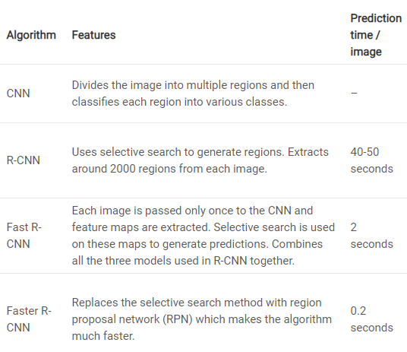
ALGORITHM: FASTER RCNN

Slide 32
ALGORITHM: FASTER RCNN
git clone https://github.com/kbardool/keras-frcnn.git
filepath,x1,y1,x2,y2,class_name
Annotate.txt
cd keras-frcnn
python train_frcnn.py -o simple -p annotate.txt
python test_frcnn.py -p test_images
CONSTRAINT:
Training was the biggest constraint as our CPU’s are not that heavy.
https://www.analyticsvidhya.com/blog/2018/11/implementation-faster-r-cnn-python-object-detection/

Slide 33
Learning and Achievements

Slide 34
Learning and Achievements
The Idea is new because there are no similar projects available as we have searched through the internet about spinal stenosis detection.
At the start of project we only had knowledge about Artificial Intelligence in Data Science mostly.
As we proceeded in project we learnt about Computer Vision and Object Detection.
We also learnt about the disease Spinal Stenosis and how it can be diagnosed through MRI.
We deserve full marks because of our hard work and dedication to our project. As we have worked accordingly with your guidelines
We deserve bonus marks as we measure up to your expectations.

Slide 35
IMPROVEMENTS & FUTURE WORK

Slide 36

IMPROVEMENTS & FUTURE WORK
Experts Opinion:
Results that the model is predicting is pure our understanding of the anatomy of the spine.
Having an expert opinion will made our model more accurate

Slide 37


IMPROVEMENTS & FUTURE WORK
APPLICATION
For now our project is only having DESKTOP APPLICATION.
Will look forward to build a web application where user can test MRI on run time.

Slide 38
THANK YOU

